Slide 1

Mentoring Makes Sense
You don’t have to be superhuman to be a mentor, but you can feel like it.
Notes:
Preparations
Materials Needed:
High School Teen Mentoring Handbooks (order for free or download a copy for each mentor: http://www.albertamentors.ca/admin/contentx/default.cfm?h=6&PageId=12232)
Pens/ Pencils
Scenario Questions
Flip Chart Paper/White Board
Computer and Projector
Optional:
Highlighters (so mentors can highlight important portions of the Handbook)
Pop/Juice/Snacks/Pizza
You may want to pre-load the videos that are linked throughout the presentation.
If students are also participating in the AMP online mentor training session, connect with the Alberta Mentoring Partnership regarding sign-in.

Slide 2

Mentor Training Session
Agenda:
1. What is Mentorship?
2. Communication
3. Child Safety
4. General Mentoring Guidelines
6. Online Mentor Training
Notes:
Introduce yourself, your agency/organization/program, and thank attendees for coming.
Encourage participants to ask questions throughout the session.
Introduce the agenda for the day.

Slide 3
What Is Mentorship?
Notes:
Introduce the topic: What is Mentorship?
Show the AMP Video - “The Benefits of Mentoring” - http://www.albertamentors.ca/admin/contentx/default.cfm?h=5&PageId=12170
Video length – 3.31 mins

Slide 4

What is Mentorship?
1. Who was/is your mentor? Why?
2. Where have you seen
mentoring relationships in the
media? (movies, TV Shows, etc).
3. What qualities do good mentors possess?
Notes:
Ask teens to discuss the following questions in partners. Give them 3 minutes to do so:
Who was/is your mentor? Why?
Where have you seen mentoring relationships in the media? (in movies, tv shows, etc).
What qualities do good mentors possess?
Have each group share an example of a mentoring relationship – either in their own lives or that they’ve seen in the media.
Have each group share a quality that a good mentor possesses. Record responses on a whiteboard or flipchart.
Some characteristics that could be highlighted:
Assertive, Confident, Approachable, Empathetic, Experienced, Patient, Creative, Consistent, Non-judgemental, Knowledgeable, Competent, Honest, Trustworthy, Accessible, Kind, Fair, Respected by their peers, Good listener.

Slide 5

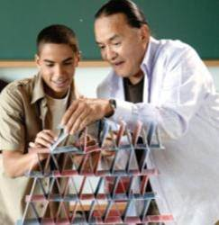

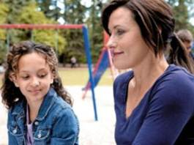
What is Mentorship?
The Alberta Mentoring Partnership defines mentoring as:
“The presence of a caring individual(s) who provides a young person with support, advice, friendship, reinforcement and constructive role modeling over time.”
Notes:
The Alberta Mentoring Partnership defines mentoring as "the presence of a caring individual(s) who provides a young person with support, advice, friendship, reinforcement and constructive role modeling over time."
Ask: What are the key words here?
(Caring, Support, Advice, Friendship, Reinforcement, Constructive Role Modeling, Over Time).
Ask Teens: What does it mean to be mentor who is……
CARING - Mentors care about the mentee in their life. They ask questions and get to know the young person. They follow through on planned visits and activities. They plan activities the child finds fun. They set appropriate boundaries.
SUPPORT – A mentor is there for a child, arrives for every visit, is on time, and encourages them. They focus on their mentee (not the other mentors/mentees). They help their mentee to create goals.
ADVICE - This doesn’t mean telling a child what to do. It means helping them solve problems by encouraging them to brainstorm all the things they could do in a given situation (solutions), and then allowing them to choose what to do.
FRIENDSHIP - This is very important! As a mentor, you are a FUN older friend, and mentorship is about building a connection with a child. Mentoring relationships are friendships, and as with new friends, they can take some time to develop. Be patient, and give both yourself and your mentee time to get to know one another.
REINFORCEMENT - Reinforcing positive behaviors and attitudes by reminding the child of all the good things about themselves and their life.
CONSTRUCTIVE ROLE MODELING - Acting how you expect the child to act. Children are sponges and they will follow your moves, so be a positive role model for them.
OVER TIME - Committing to the full duration of the program, and showing up for every visit, is essential in building a trusting relationship with a child.

Slide 6
What is Mentorship?
Improved
attendance
Research has shown that children in a Teen Mentoring Programs demonstrate:
Improved
social and
communication
skills
Improved
self confidence
and self esteem
mentoring
mentoring
Notes:
ASK: Why do you think it’s valuable for kids to have a Teen Mentor? What kind of an impact can you have on a child?
(These answers could be recorded on a white board).
Mentees in the Teen Mentoring Program have demonstrated improvements in the following areas:
Knowing they need to be in school
Trying harder in school
Feeling they have good ideas
Feeling better about themselves
Getting along better with others (friends, family, peers, teachers)
Feelings of social acceptance
ASK: What can YOU do to impact a child’s attitude about school, self esteem, and relationships?
Examples:
School - Help the child discover an academic strength or skill.
Self Esteem – Arrive on time, every time you have a scheduled visit (this demonstrates to a young person that you believe they’re important).
Relationships – Role model positive friendship skills (such as sharing, being polite, being considerate, etc).

Slide 7
What is Mentorship?
Notes:
Mentoring relationships across Canada have proven to have some very beneficial impacts (from a recent Big Brothers Big Sisters of Canada study). Mentored Youth Simply Do Better!
Possible Activity Break - A MENTORING STORY
Instruct kids to listen carefully to the upcoming Mentoring Story. When they hear the word ‘mentoring’ they must jump up, when they hear the word ‘mentor’ they must jump and spin and when they hear the word ‘mentee’ they must run on the spot for 5 seconds.

Slide 8
What is Mentorship?
“Someone’s gotta be crazy about the kid.”
- Urie Bronfenbrenner
Notes:
Read the following story:
One of the most famous researchers in psychology, a professor named Urie Bronfenbrenner who taught at Cornell University, retired after 40 years of service to the field. His research added more than a dozen, new, important terms and concepts to the science of human development. Before the US Senate, attended by hundreds of politically important people, he was asked to provide a summary of what his 40 years of research could teach us about child development. He stood up, went to the podium, tapped on the microphone, cleared his throat and said: “Someone’s gotta be crazy about the kid.” Then he sat down.
Your job is to be that person who makes the kid feel like you are crazy about him or her. If your Little is failing classes or often misbehaves, then your Little likely has more than a handful of adults who are critical and tell him or her how to be, act, or think differently. What your Little likely lacks, though, is someone to say—regardless of those problems—“There are some really special things about you. Let me show you and tell you why that is so important to remember.”
Your purpose as a mentor is to make your mentee feel special. That’s your job!
© 2008 by Big Brothers Big Sisters of America
Lessons by Michael Karcher. Story used with permission.
Big Brothers Big Sisters High School Bigs Mentor Training
http://www.highschoolbigs.org/

Slide 9
Communication
Notes:
Introduce the topic: Communication

Slide 10

Communication
Activity: What Am I Really Saying?
_{Adapted from Heart-to-Heart¹}
break into groups of 4
choose 1 member of your group to be the Actor
each Actor will be given a scenario that they are not to show to their group
the Actor will then act out the scenario to their group
¹Limoges, J. & Vonde, D. (2009). Training Manual Heart-to-Heart.
Notes:
ACTIVITY: What Am I Really Saying?
Adapted from Heart-to-Heart
¹Limoges, J. & Vonde, D. (2009). Training Manual Heart-to-Heart.
Break teens up into groups of approx. four people.
Have one teen in each group volunteer to be the “actor.” Give the Actor a Scenario Card, and ask them not to show their group. Have the actor act out the scenario to their group.
What Am I Really Saying? Scenarios:
Actor: Explain to your group that you are really excited about being a mentor and what you are looking forward to about the experience. BUT! Do not smile, use a monotone voice, and sound bored. Cross your arms and do not make eye contact with your group while you’re speaking.
Actor: Think about a bad day you’ve had, or make up a bad day, and tell the group about it in a very cheerful, happy voice, even laughing at the worst parts. Make eye contact with the group and smile a lot. Lean forward and use excited hand gestures.

Slide 11
Communication
Activity: What Am I Really Saying?
_{Adapted from Heart-to-Heart¹}
Communication is
  7% words/what you say
  38% how you use your voice (tone)
  55% non-verbal (facial, body language, posture…)
What does this activity teach you about
Your Mentee?
Your Role as a Mentor?
¹Limoges, J. & Vonde, D. (2009). Training Manual Heart-to-Heart.
Notes:
Bring the group back together and discuss the following questions as a large group:
What did you think of this activity?
What was the actor saying?
What was the actor feeling?
Were their words and actions lining up?
What did you learn? How does this relate to mentoring?
The point is that the non-verbal communication and the verbal communication in the scenarios did not line up.
When we communicate to our mentee, as well as listen when they communicate to us, we need to pay attention to words, tone of voice, and non-verbal communication.
Communication is:
7% words/what you say
38% how you use your voice (tone)
55% non-verbal (facial, body language, posture…)
What does this activity teach you about:
1. Your mentee?
Don’t just listen to their words, but also to their body language, tone of voice, etc.
If they say they’re happy, but they seem unhappy, what could you do?
Comment about it: “You seem sad. What’s going on?” or just ask them how their day is going. Take an interest in what’s going on in their lives.
2. Your role as a mentor?
Your actions and body language are just as important as the words you say. They communicate a lot to your mentee.

Slide 12
Communication
How can you communicate to your mentee that you are listening and you care?
Eye contact
Minimal Encouragers - Nodding, “Yes,” “Mm-Hmm.”
Repeating, summarizing, and paraphrasing what the child has said.
Asking questions about what the child has said.
Postponing your responses until the child has finished talking – don’t interrupt.
Put away your cell phone and iPod.
Focus on your mentee – not on other mentors/matches.
Open posture
Notes:
If your actions and body language are just as important as the words you say, what do you need to do to show that you’re listening to your mentee and that you care about them?
Ask the teens to demonstrate body language that would indicate that they are not listening to you.
Next, ask teens to demonstrate body language that would indicate that they are listening carefully to what you’re saying.
Ask: What will demonstrate to your mentee that you are listening and you care?
Eye Contact
“Minimal Encouragers” – Nodding, “yes,” “Hm-mm.”
Repeating, summarizing, and paraphrasing what the child has said.
Eg. Mentee: I had a bad day.
Mentor: It sounds like things didn’t go well for you today.
Asking questions about what the child has said.
Postponing your responses until the child has finished talking – don’t interrupt.
Put away your cell phone and ipod!!!!
Focusing on your mentee – not on other mentors/matches.
Open posture– leaning forward, not crossing your arms
More on Pages 34-37 in your Handbook (encourage further reading of this section at home).

Slide 13

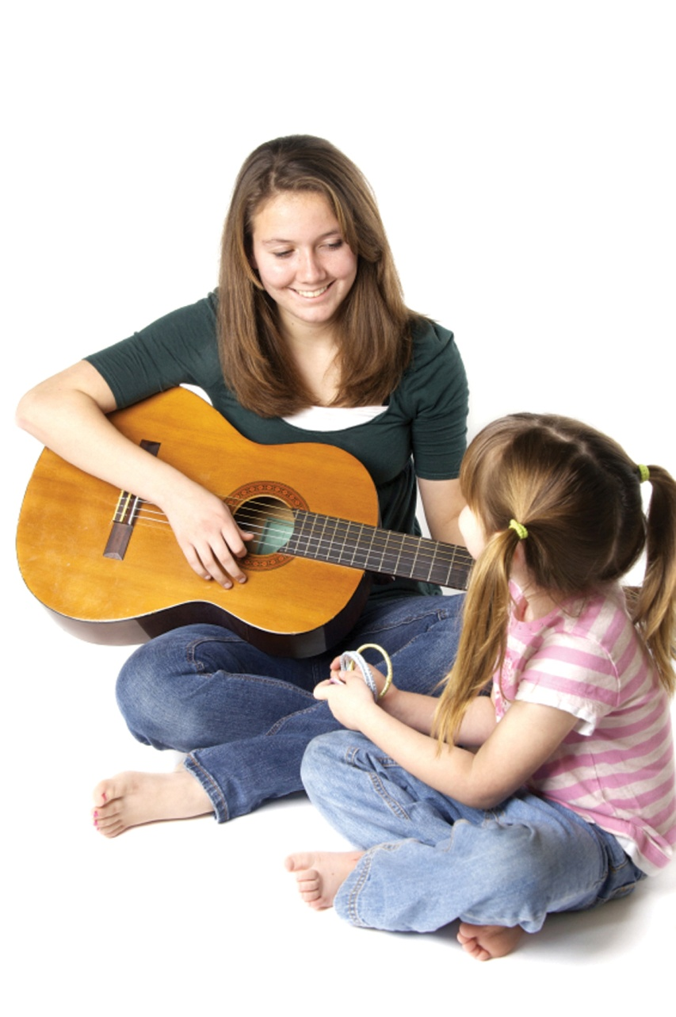
Communication
How can you engage your mentee?
1. Ask questions!
2. Have fun!
Notes:
ASK: How can you engage your mentee? What are you going to do to begin a relationship with your mentee?
Some suggestions:
Conversation. Ask about the child’s family, friends, pets, interests, etc. And actively LISTEN to their answers.
Engage in fun activities such as sports, crafts, and games. Be present and engage in FUN with your mentee.

Slide 14
Child Safety
Notes:
Possible Activity Break
Famous Mentor Guessing Game - Hand out a card with a famous mentor to each participant. Give them 5 minutes to walk around the room trying to figure out who they are.
Introduce the third topic: Child Safety

Slide 15

Child Safety
What kinds of safety principles could you teach a child?
Examples
Safety while baking
Using playground and gym
equipment appropriately
Internet safety
Notes:
No one can protect a child 24 hours a day, every day, so it’s important to teach kids how to protect themselves. When opportunities arrive to teach kids safety lessons, take advantage of them.
ASK: What are possible safety messages that you could teach a child while you are matched to them?
Examples…
Safety while baking – washing hands, turning pot handles in, being careful around the oven/stove.
Using Playground and Gym equipment appropriately
Internet safety
Never give out personal information (address, phone number)
Don’t send your picture to anyone
Never agree to meet someone you’ve “met” online
Remember that you cannot see the people you talk to on the internet
People may not be who they say they are.
Do not respond to any messages that are mean or make you feel uncomfortable. If you get this kind of message, tell your parent/guardian or a teacher right away.

Slide 16

Child Safety
Secrets & Surprises
Surprises are good things that, after a while, you tell someone about and it makes them happy.
Secrets are things that people might tell you to keep to yourself or never tell anyone about.
No Secrets Ever!
Notes:
Secrets and Surprises
Explain: Surprises are things that, after a while, you tell someone about and it makes that person happy. A surprise might be a birthday gift for your friend. You don’t tell your friend what the present is—for a little while. Then you give her the gift and she is surprised and happy. But secrets are things that people might tell you to keep to yourself and never tell anyone about. In mentoring matches, it’s okay to keep surprises, but not secrets. Secrets exclude others and can sometimes be dangerous.
For both your own protection and the child’s, do not keep secrets!
It is okay to have a surprise but secrets are not okay. We ask all Mentors to be careful of the language they use when talking to the child.
For example, don’t have a “secret handshake,” but rather, a “special handshake” or a “friendship handshake.”
Have student flip to P. 49 in the High School Teen Mentoring Handbook and highlight: “No secrets ever!”

Slide 17
Child Safety
Role modeling safe behaviour is very important!
It is part of your role as a mentor is to ensure that your mentee is safe while they are visiting with you.
Notes:
STATE: As a mentor, role modeling safe behaviour is very important!
Follow the rules yourself
Use judgment and common sense in selecting activities
Contact your program coordinator if you are ever uncertain
STATE: It is part of your role as a mentor is to ensure that your mentee is safe while they are visiting with you. This means ensuring that they are safe on the playground, in the gym, while baking, etc.
If something occurs and your mentee is hurt, find an adult right away (program coordinator, teacher, etc). Do not attempt to treat a child on your own.

Slide 18
Child Safety
Abuse Issues
If you ever have concerns, questions, or instincts about a child potentially at risk, talk with your program coordinator THAT DAY.
Don’t wait!
Notes:
Introduce the next section in Child Safety: Abuse Issues.
Refer to pages 45-49 in the High School Teen Mentoring Handbook.
State: If you ever have concerns, questions, or instincts about a child potentially at risk, talk with you program coordinator THAT DAY. Don’t wait!
STATE: The purpose of this section is to highlight signs and symptoms of different types of chid abuse. Please note that the following signs and symptoms are not to be seen as exhaustive, but are examples or indicators of child abuse and neglect. We go over this section in training because when working with children, this is always a possibility.
State: If any of the content related to abuse issues has been upsetting or unsettling for you, please either speak with us (facilitators) or find an adult you trust to speak with.

Slide 19
Child Safety
Types of Abuse:
It is the combination, frequency and duration of indicators that should alert you to a problem.
Physical
Neglect (note: there is a difference between neglect and poverty)
Emotional
Sexual
Handbook pages 45 – 47
Notes:
It is the combination, frequency and duration of indicators that should alert you to a problem.
Read through the Signs and Symptoms of Various Types of Abuse (p.45-47).
This can be done in different ways, depending on the group:
You can have teens read these pages quietly on their own, then “quiz” them by asking what each type of abuse is and what the signs are.
Facilitators can read through the definitions and signs, while the teens listen and read along.
You can go around the room and have each teen read a definition/sign out loud, while the whole group follows along.
NOTE: There is a difference between Neglect and Poverty! If a caregiver has the means to provide the requisite care for a child and fails to do so, it is neglect.

Slide 20
Child Safety
Disclosures of Abuse
Direct Disclosure: A child directly tells someone they are experiencing abuse.
Indirect Disclosure: Other people notice behaviours or signs indicative of abuse in the child.
Notes:
STATE: There are two types of disclosures:
Direct disclosures
Direct disclosures are incidents where a child directly tells someone they are experiencing abuse.
2. Indirect disclosures
Indirect disclosures are incidents where other people notice behaviours or signs indicative of abuse in the child.

Slide 21
Child Safety
How to respond to a disclosure of abuse:
Stay calm.
Listen.
Reassure the child.
Report it.
Notes:
If you receive a disclosure:
1. Stay Calm.
If the child sees you are agitated they may not continue.
2. Listen.
Resist the urge to gather details. Leave that to a trained professional. Asking “leading questions” may compromise an investigation later on.
The most important point is that the child knows you believe them. All you need to do is listen!
3. Reassure the child.
Thank them for telling you.
Tell them it is not their fault.
Tell them you will do your best to find help.
Do not promise to keep the information a secret.
4. Report the abuse.
Talk to your program coordinator!
Your program coordinator will speak with you about next steps. This could include a conversation with the child’s teacher and/or principal, and potentially a call to Child & Family Services. Your program coordinator will be there to support you, regardless of what happens next.
You are legally obligated to report any knowledge you may have of child abuse.
STATE: Always include your program coordinator in the process and share your feelings, concerns, and actual steps taken. Do not sit alone with a disclosure!

Slide 22
General Mentoring Guidelines
Notes:
Possible Activity Break
Obstacle Course: Have participants partner up. One is blindfolded and the other must lead him/her around the room. This activity is meant to show that mentors are also guides and teachers.
Introduce the topic: General Mentoring Guidelines

Slide 23
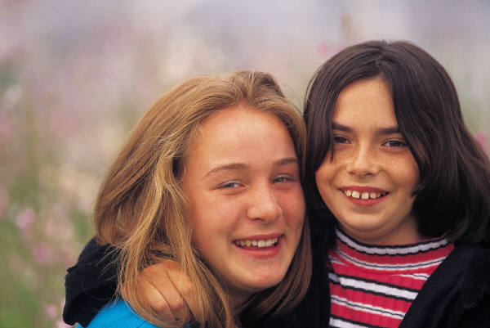
General Mentoring Guidelines
Can I hug my mentee?
Notes:
Explain: The next few slides will discuss common questions that Teen Mentors have, and the guidelines that follow them.
Encourage mentors to guess the answers by voting “yes” or “no” to each question. You could have them stand for “yes” and sit for “no,” or give a thumbs up or thumbs down.
Q: “Can I hug my mentee?”
A: Yes, but there are some important guidelines around physical contact to make note of.

Slide 24
General Mentoring Guidelines
Yes, you can hug your mentee. But…
Guidelines for Physical Contact
Respect the child’s wishes.
Allow the child to initiate contact (including hugs).
Respect your own feelings about physical contact.
Err on the side of caution.
Be aware of how others might perceive your actions.
Notes:
STATE: The following guidelines will help you determine what physical contact is appropriate with your mentee:
1. Respect the child’s wishes.
Be alert to messages pertaining to personal space (listen to body language and tone of voice – not just words)
For some children, even the briefest and least intrusive physical contact is not comfortable.
Accept the child’s wishes and adjust your own behavior accordingly.
2. Allow the child to be the one who initiates physical contact.
By allowing the child to be the one to initiate contact you are enabling them to set boundaries around the physical contact they feel comfortable with.
3. Respect your own feelings about physical contact.
Physical contact is a personal decision.
If the child is more affectionate than you are comfortable with it is acceptable to set boundaries with them.
4. Err on the side of caution.
If you are uncertain whether or not something is appropriate, refrain from the contact and discuss your concerns with your program coordinator.
5. Be aware of how others might perceive your actions
Different cultures have different customs
School staff, parents, etc. will be around during your visits – think about what their perception of the contact might be

Slide 25
General Mentoring Guidelines
Unacceptable Forms of Physical Contact with a Mentee:
Kissing
Cuddling
Wrestling or Roughhousing
Sitting on laps
Tickling
Piggy-backs
Notes:
State: The following forms of physical contact are unacceptable with a mentee:
Kissing or Cuddling
Wrestling or Roughhousing
Sitting on laps
Tickling
Piggy-backs

Slide 26

General Mentoring Guidelines
Can I post pictures of my mentee on Facebook?
Notes:
“Can I post pictures of my mentee and I on Facebook?”

Slide 27
General Mentoring Guidelines
No. Confidentiality in your match is
very important.
Confidentiality:
Assuring the protection of sensitive information regarding children, families, and mentors within the mentoring relationship.
Notes:
No. Confidentiality in your match is very important.
Confidentiality: Confidentiality is assuring the protection of sensitive information regarding children, families, and mentors within the mentoring relationship.
In the course of your service as a Mentor, you may learn intimate, personal facts about your mentee and their family. We ask that you not discuss these matters with anyone other than your program coordinator.
Please note:
You’re expected not to mention your Mentee’s last name or identifying information when talking to others about your time together. You can discuss your Mentee with your Program Coordinator if you have any questions or concerns.
Discussions regarding your Mentee during check-in sessions (with the Program Coordinator) must be held in strictest confidence and may not be discussed outside of these sessions.
You may use your experiences with your Mentee for class projects, provided that their name, school, and identifying information are omitted to protect their identity.
Anything discussed during training or group activities amongst Mentors is to remain confidential.
Do not post any identifying information or photos of your mentee anywhere on the internet (Facebook, Instagram, nexopia, myspace, etc).

Slide 28
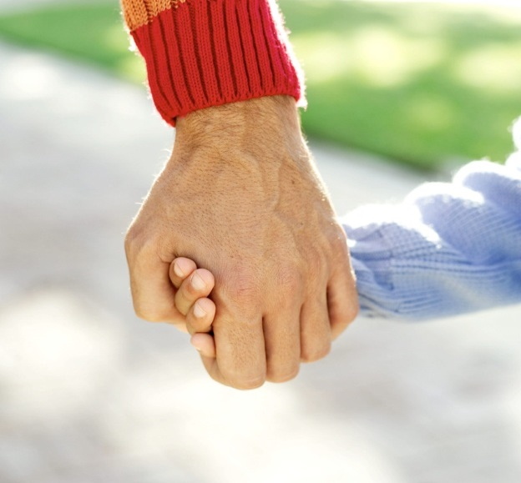
General Mentoring Guidelines
Is it okay to say “no” to my mentee?
Notes:
“Is it okay to say ‘no’ to my mentee?”

Slide 29
General Mentoring Guidelines
Yes, we encourage you to set appropriate boundaries with your mentee.
Setting Boundaries: Scenarios
In your groups, discuss what you would do in the scenario given to you.
Be prepared to share about your discussion.
Notes:
Yes, we encourage you to set appropriate boundaries with your mentee.
Break the teens into groups of 2-4, and give each group a scenario question. Give them 5 minutes to discuss what they would do in the scenario given to them.
Have each group present their scenario. This could be done in different ways, depending on the group:
They could act out the scenario given to them, and act out how they would respond.
They could read the scenario out and share what they discussed.
Provide feedback and encouragement to each group as they present.
If you are short on time, you could choose a few scenarios to read to the entire group, and have the whole group discuss the appropriate response.
Scenarios:
1. Your mentee does not want to do any of the activities that you have suggested. When you ask them what they want to do, they say “I don’t know.” How would you respond?
2. Your mentee is easily distracted and keeps leaving the activity you’re doing together to visit with other kids. How would you respond?
3. You and your mentee are playing soccer together and you are trying to teach him/her a new soccer move. Your mentee tells you he/she can’t do it and refuses to try. How
would you respond?
4. Your mentee asks to go get a drink at the water fountain. While waiting in line, he/she pushes the child in front of him/her and tells the child they’re dumb for taking so long.
How would you respond?
5. Your mentee tells you that he/she hates school. How would you respond?
6. Another match has baked cookies and, without asking, your mentee takes a cookie off the tray when the match isn’t looking. How would you respond?
7. While speaking with your mentee, they say a swear word. How would you respond?
8. Your mentee is very talkative, however you notice that many things they share appear to be an exaggeration or a lie. How would you respond?
9. Your mentee asks to go get a drink at the water fountain. While waiting in line, he/she pushes the child in front of him/her and tells the child they’re dumb for taking so long.
How would you respond?
10. At the end of the visit, your mentee refuses to go back to class/home. How would you respond?
11. Every time you and your mentee play a game, your mentee cheats to win. If he/she doesn’t win, he/she gets upset. How would you respond?
12. Your mentee asks if they can bring a friend along on the visit. How would you respond?
13. Your mentee asks for your phone number and asks if you can go to the park together on the weekend. How would you respond?

Slide 30

General Mentoring Guidelines
Setting Boundaries
Be a friend while maintaining the role of a more mature person.
Take advantage of opportunities to be a positive role model.
Acknowledge inappropriate behaviour.
Say “no” to inappropriate requests.
Be consistent.
Praise the child when they make appropriate choices.
Set realistic expectations from the beginning of the match.
Notes:
Setting Boundaries:
In many of the scenarios, there were situations where children were pushing boundaries or where it was beneficial to set boundaries with them.
A boundary can be thought of as a protective barrier that helps to keep us safe. For boundaries to be effective they need to be applied on a consistent and ongoing basis. Boundaries teach children what healthy relationships look like and allow them to be children.
Tips for Setting Boundaries:
1) Be a friend to the child while maintaining the role of the adult.
Part of being a mentor means helping the child to understand the rules and expectations of society.
2) Take advantage of opportunities to be a positive role model.
Children are impressionable; take advantage of the teachable moments. Exhibit the behaviour that you require from them, yourself.
Demonstrate appropriate social skills and respect in relationships
3) When the child acts inappropriately, acknowledge the behaviour or action.
Use the opportunity to discuss why the child acted in such a manner and explain why it was inappropriate. Do not just ignore the behaviour.
Do not attempt to punish the child for the behaviour as it is important to re-enforce that your friendship is unconditional (E.g. Do not cancel a visit.)
4) Say “no” to inappropriate requests.
Saying “no” can be a positive experience for both parties if the situation is handled appropriately.
Explaining the reasoning behind decisions. Enabling the child to search for alternatives can be an empowering experience.
5) Be consistent.
Once you have spoken to the child in regards to inappropriate behaviour, continue to reinforce messages if similar behaviours are displayed.
6) Praise the child when they make appropriate choices.
Focus on the child’s positive behaviour; praise them when they do something appropriate.
7) Set realistic expectations for visits from the beginning of the match.
Buying the child a gift, giving the child money, visiting for longer than required, or planning a costly activity at the start of the friendship will lead the child to expect that this will be the norm for the duration of the friendship.
If you ever begin to feel frustrated or unsatisfied in your role as a mentor, there are two important things to do: (1) find support in your program coordinator; (2) focus on your purpose as a mentor, which is to make your mentee feel special.

Slide 31
General Mentoring Guidelines
Additional Guidelines
Stay on school/site property
Use designated washrooms for volunteers
Stay in visible places with your mentee
Clean up after each activity
Dress appropriately
Absent policy
Proper closure should take place when the match ends
Focus on your mentee, not the other mentors
Notes:
Additional things to keep in mind:
Matches must stay on school/site property. Be aware of school/site boundaries.
Always use designated washrooms for volunteers.
Always work in places you are visible – don’t close doors.
Leave the space as you found it – clean up all equipment and supplies.
Dress appropriately – Remember the “3 B’s”: No butts, no boobs, no bellies. Be careful with slogans and brand names.
Absent policy – share what mentors should do if they have to miss a visit.
If you have to close the match early, speak with your program coordinator and plan for a final visit with the child. Do not just quit coming! Also, when the end of the year/program arrives, be sure to count down with the child to your last visit (so it does not come as a surprise). Do not make promises about future contact.
Focus on your mentee, not the other mentors - It may be hard sometimes to focus on your mentee, but now is your time to make your him/her feel good.

Slide 32

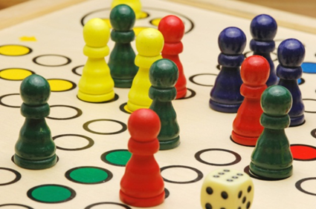
General Mentoring Guidelines
    Tips for Planning Activities:
    Child-centered
    Ask your mentee
    Be flexible
    Bring in activity supplies
    Utilize available resources
      Toy Box
      High School Teen Mentoring
      Activity Book
      Your Program Coordinator
      The library
      The Web
Notes:
It’s helpful to plan activities ahead of time that you and your mentee can do together. If you have a plan for how you’re going to fill the hour with your mentee, they are more likely to be engaged and entertained. This will alleviate many behavioural difficulties that could occur if the child is bored.
Tips for Planning Activities:
Child-centered: Activities should focus on things the child is interested in.
Ask your mentee: what they would like to do
Ask your mentee at the end of each visit: What did you enjoy about our visit today? What do you want to do next week? Plan accordingly.
Be flexible: the activity may not go as planned. Be willing to modify the activity based upon the child.
Bring in activity supplies: You are welcome to bring in activities and activity supplies to use with your mentee. If there’s something special that you feel would enhance your visits, speak with your Program Coordinator about it.
Utilize available resources
Toy Box (if you program has supplies like this)
High School Teen Mentoring Activity Book : http://www.albertamentors.ca/public/data/documents/MentoringActivityBookpdf.pdf
Your Program Coordinator
The library
The Web (google it!)

Slide 33

Video: Michelle Obama speaks at the 2011 National Mentoring Summit
Notes:
Do the below activity, then show video – Michelle Obama speaking about mentoring relationships at the 2011 National Mentoring Summit.
Video link:
Activity (related to Michelle Obama video) – MENTOR SANDWICH
- Have each participant write their name on a recipe card (or use their name tag).
In the space above their name, write the name of someone who has been a mentor to them.
Below their own name, write the name of someone they are currently mentoring.
Finally, to the right of their own name, write the name of someone in their life who is encourages and supports them.
Give the participants 1 minute to find someone that isn’t sitting beside them and discuss why they have written the name above their own– share stories.
Next minute, find a new person to share the name of the person below their name.
Finally, another minute to find one more person to discuss the name to the right.
Once game is completed and everyone is back at their seats, play the video (2.20 in length)

Slide 34
Online Mentor Training
moodle.albertamentors.ca
Notes:
If you are also having the mentors complete the online training, this is the website. Connect with the Alberta Mentoring Partnership regarding: sign in.

Slide 35


Questions?
Notes:
Ask mentors if they have any additional questions.
If time allows, ask participants to share a “golden nugget” or “ah-ha” moment from the training session. Ask them each to share one thing that was really helpful and that they’ll remember from the session.

Slide 36


Thank You!
Notes:
Thank the teens for their attendance and attention.

